Slide 1
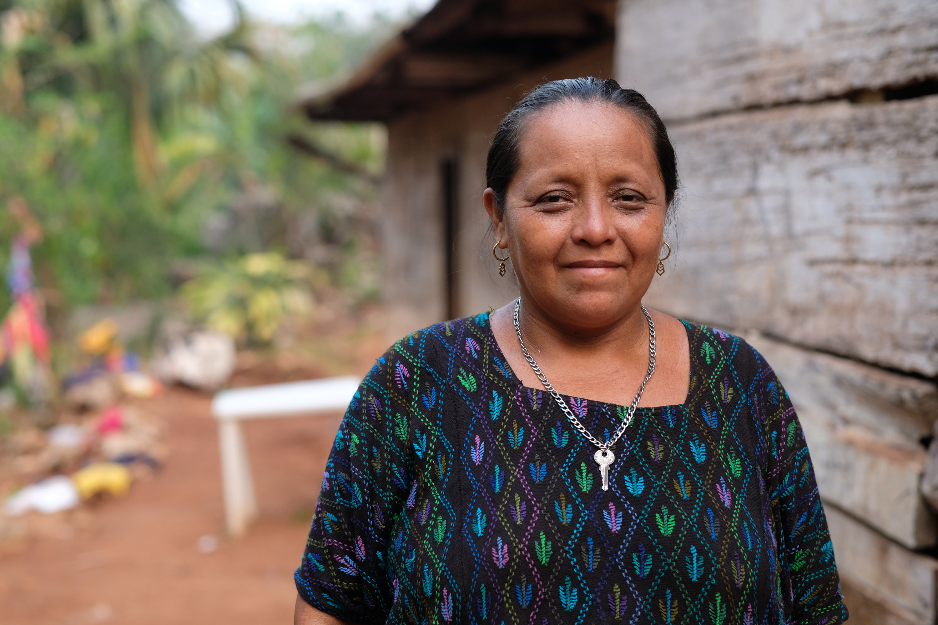

Aurelia
cacao farmer and
community leader in Guatemala

Slide 2
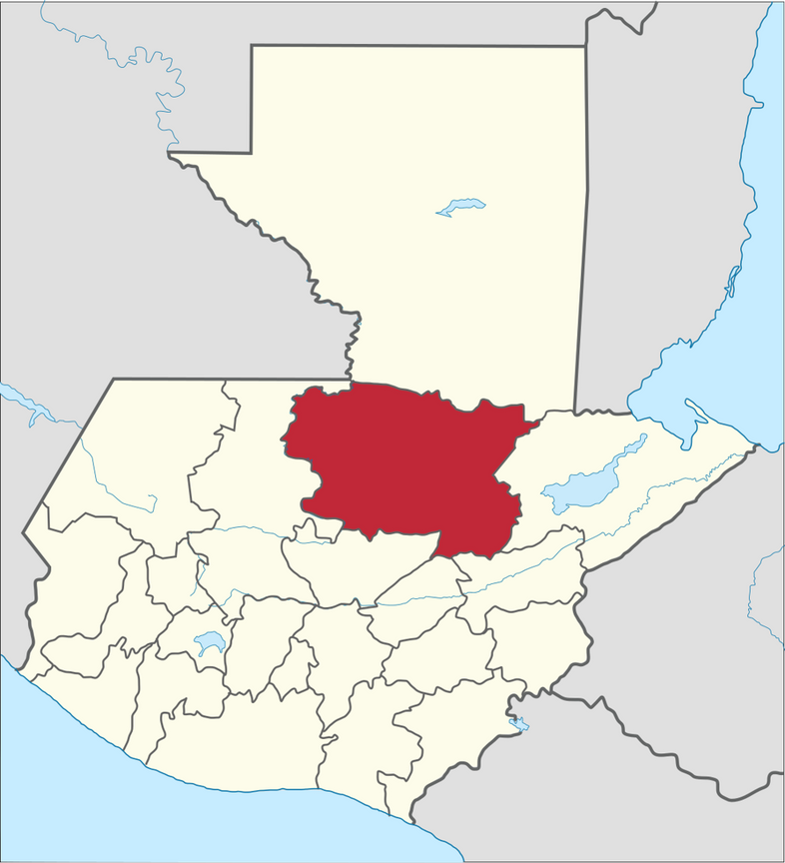
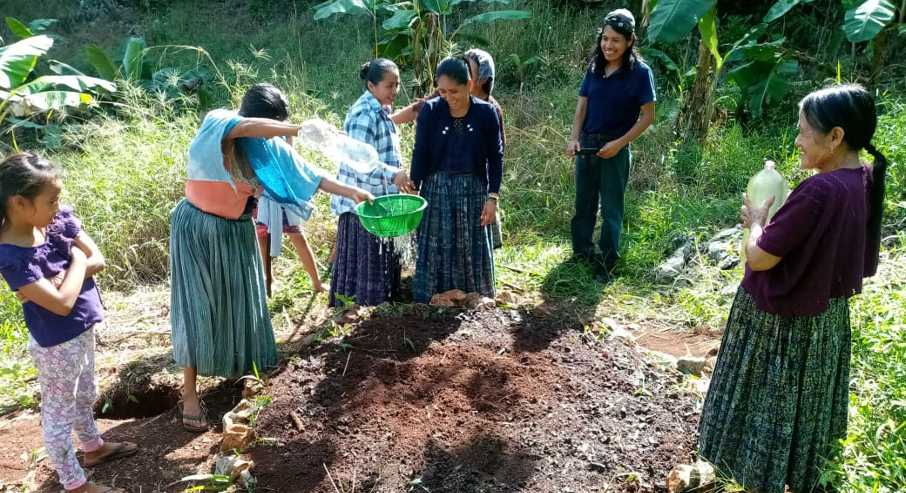
Donaldo, Congcoop Agroecological Facilitator, with a group of Indigenous farmers during their monthly training session
Guatemala
Alta Verapaz

Slide 3
Lydia’s Conversion in Philippi
Acts 16 v 11-15
From Troas we put out to sea and sailed straight for Samothrace, and the next day we went on to Neapolis. From there we traveled to Philippi, a Roman colony and the leading city of that district of Macedonia. And we stayed there several days.
On the Sabbath we went outside the city gate to the river, where we expected to find a place of prayer. We sat down and began to speak to the women who had gathered there. One of those listening was a woman from the city of Thyatira named Lydia, a dealer in purple cloth. She was a worshiper of God. The Lord opened her heart to respond to Paul’s message. When she and the members of her household were baptized, she invited us to her home. “If you consider me a believer in the Lord,” she said, “come and stay at my house.” And she persuaded us.

Slide 4
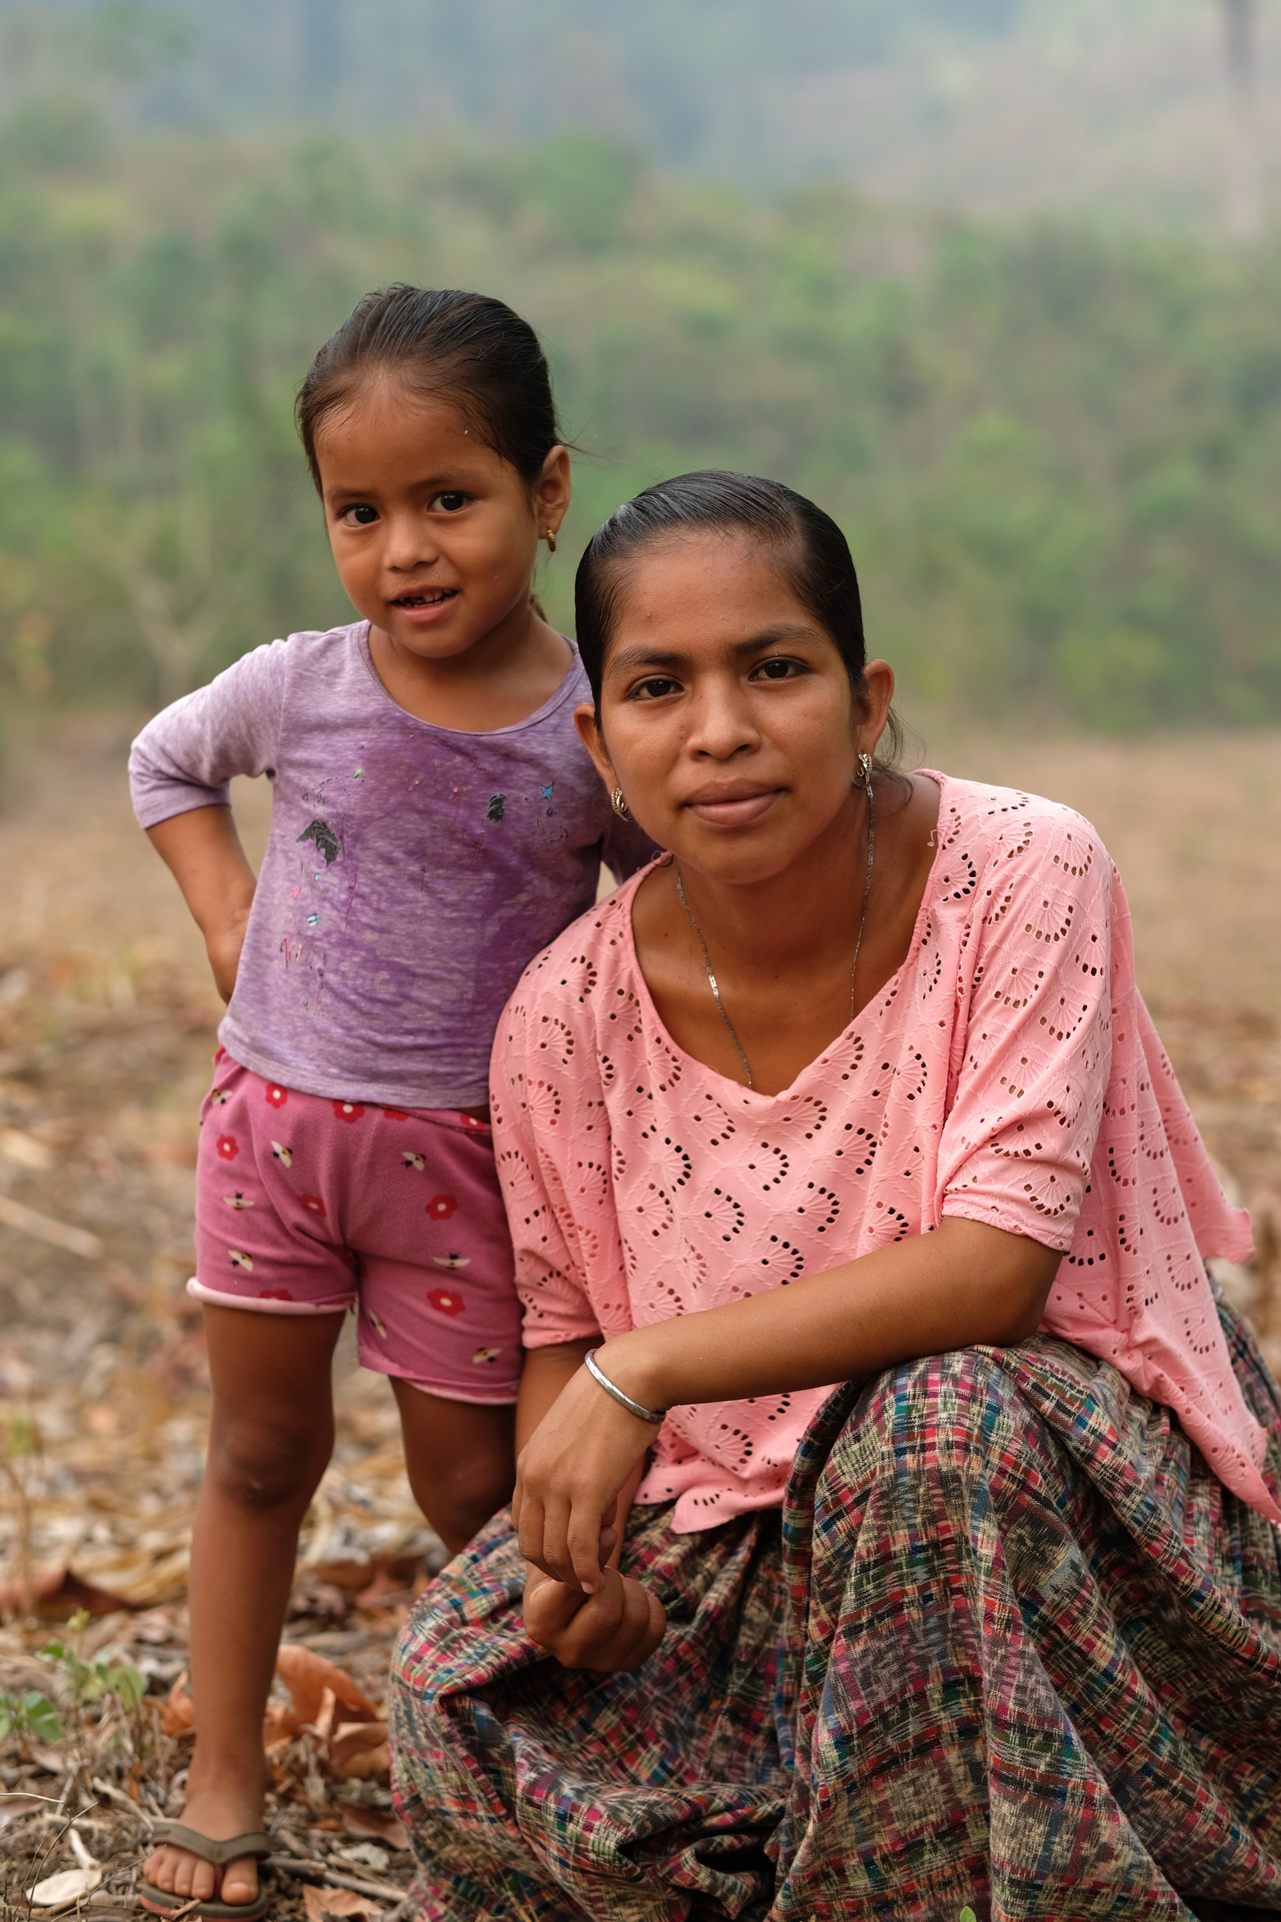
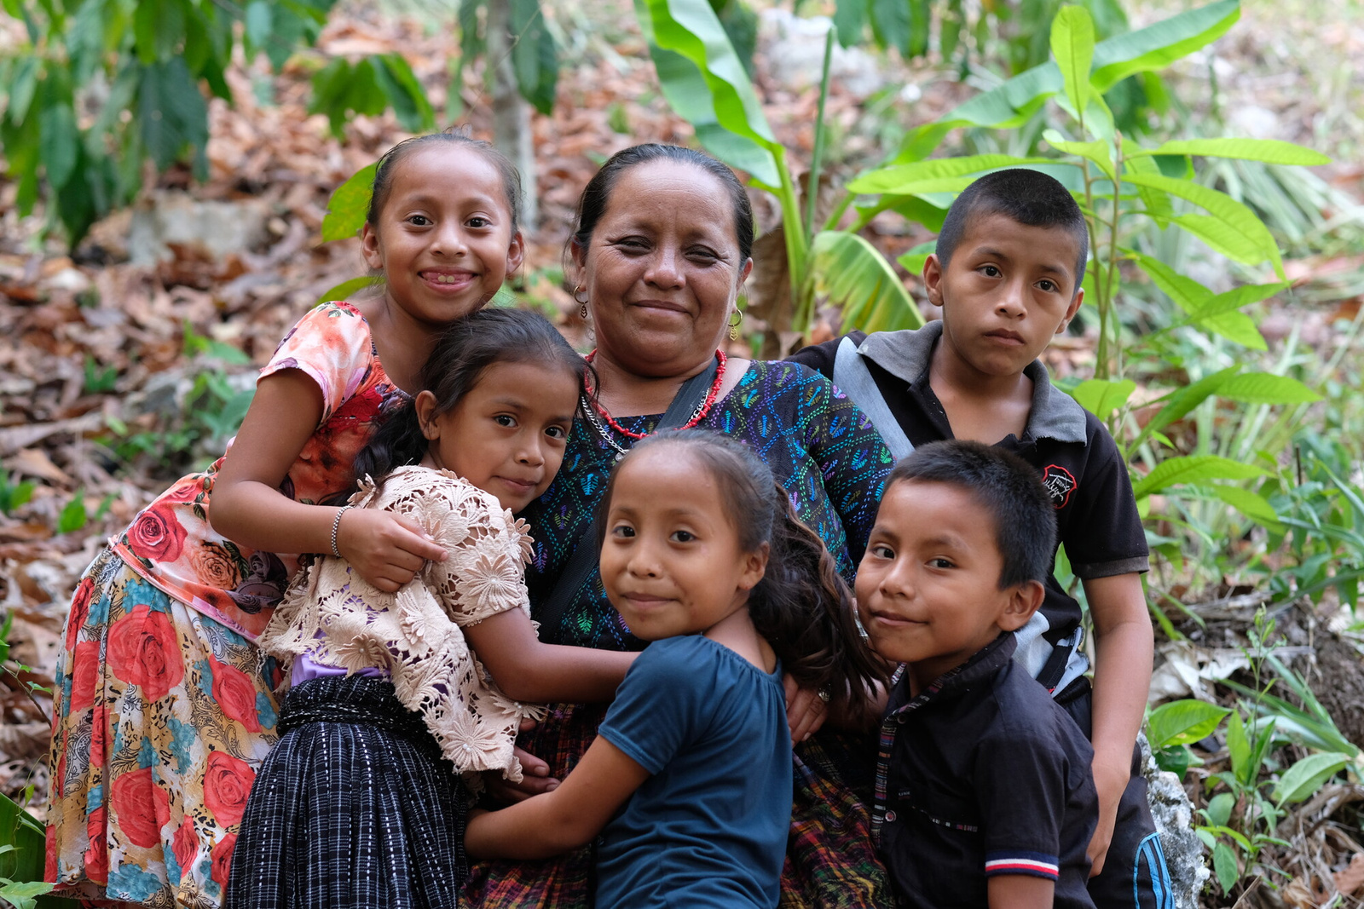
Amelia
Aurelia

Slide 5
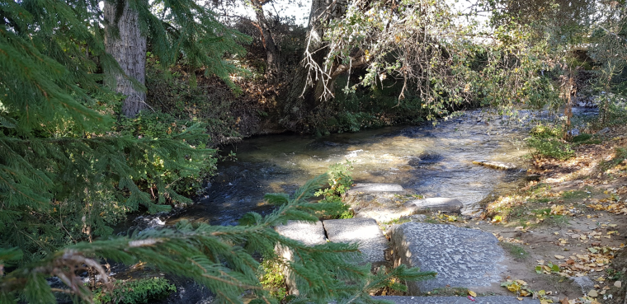
River Gangites, outside of Philippi
When they arrived at Salamis, they proclaimed the word of God in the Jewish synagogues.
Acts 13
At Iconium Paul and Barnabas went as usual into the Jewish synagogue.
Acts 14
When Paul and his companions had passed through Amphipolis and Apollonia, they came to Thessalonica, where there was a Jewish synagogue.
Acts 17

Slide 6
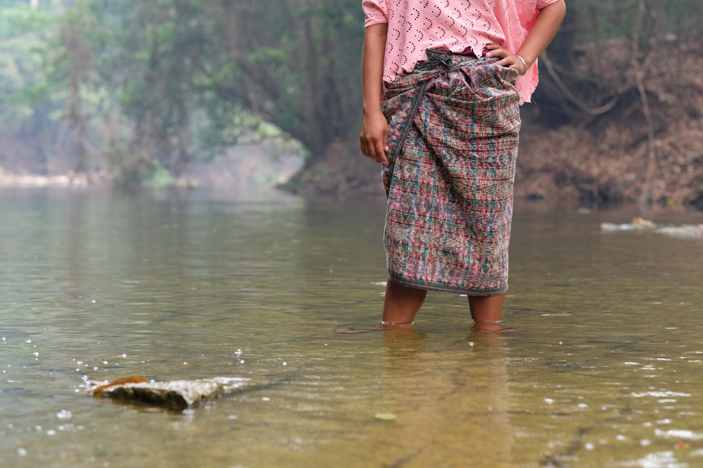
“
The river used to reach to my waist, now it is very shallow at ankle height. As a child, I remember the river was deeper and bigger, there were crabs shrimp and big fish. Animals and fish have started dying. I am very worried about it. The river is also contaminated by agro-industry that has been exploiting it.
Amelia

Slide 7
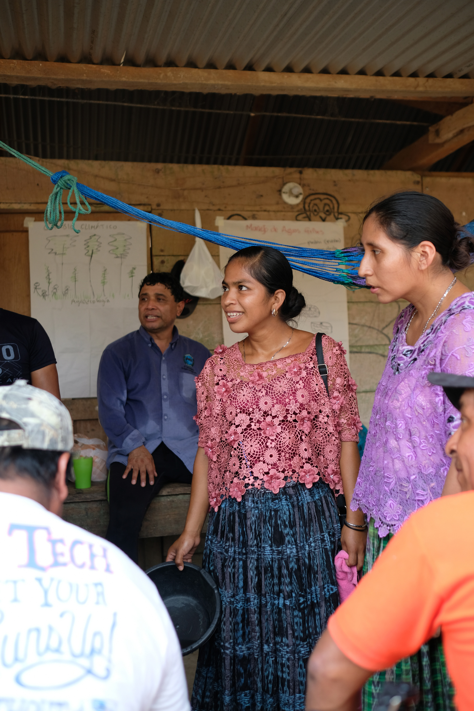
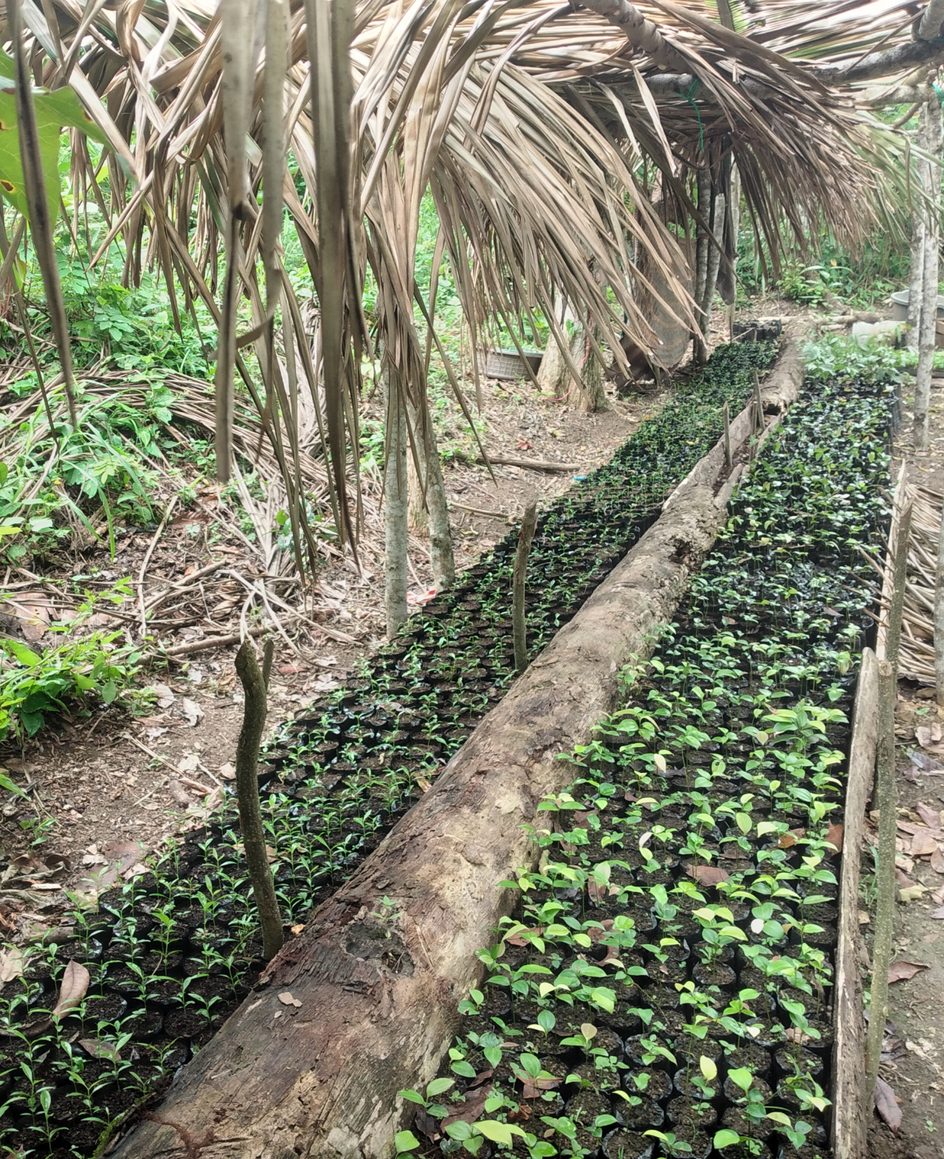
Planting schedules should lead to multiple harvests
Amelia attending agroecology training with Congcoop

Slide 8
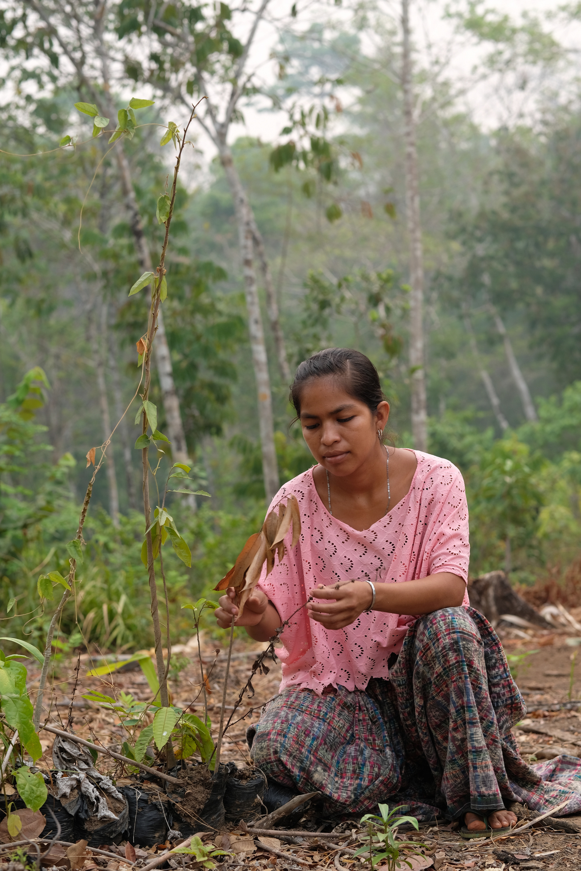
“
This is my land. My plantations have been dying due to the lack of water, and in terms of how it’s affecting me: there is no food for my family.
Amelia

Slide 9
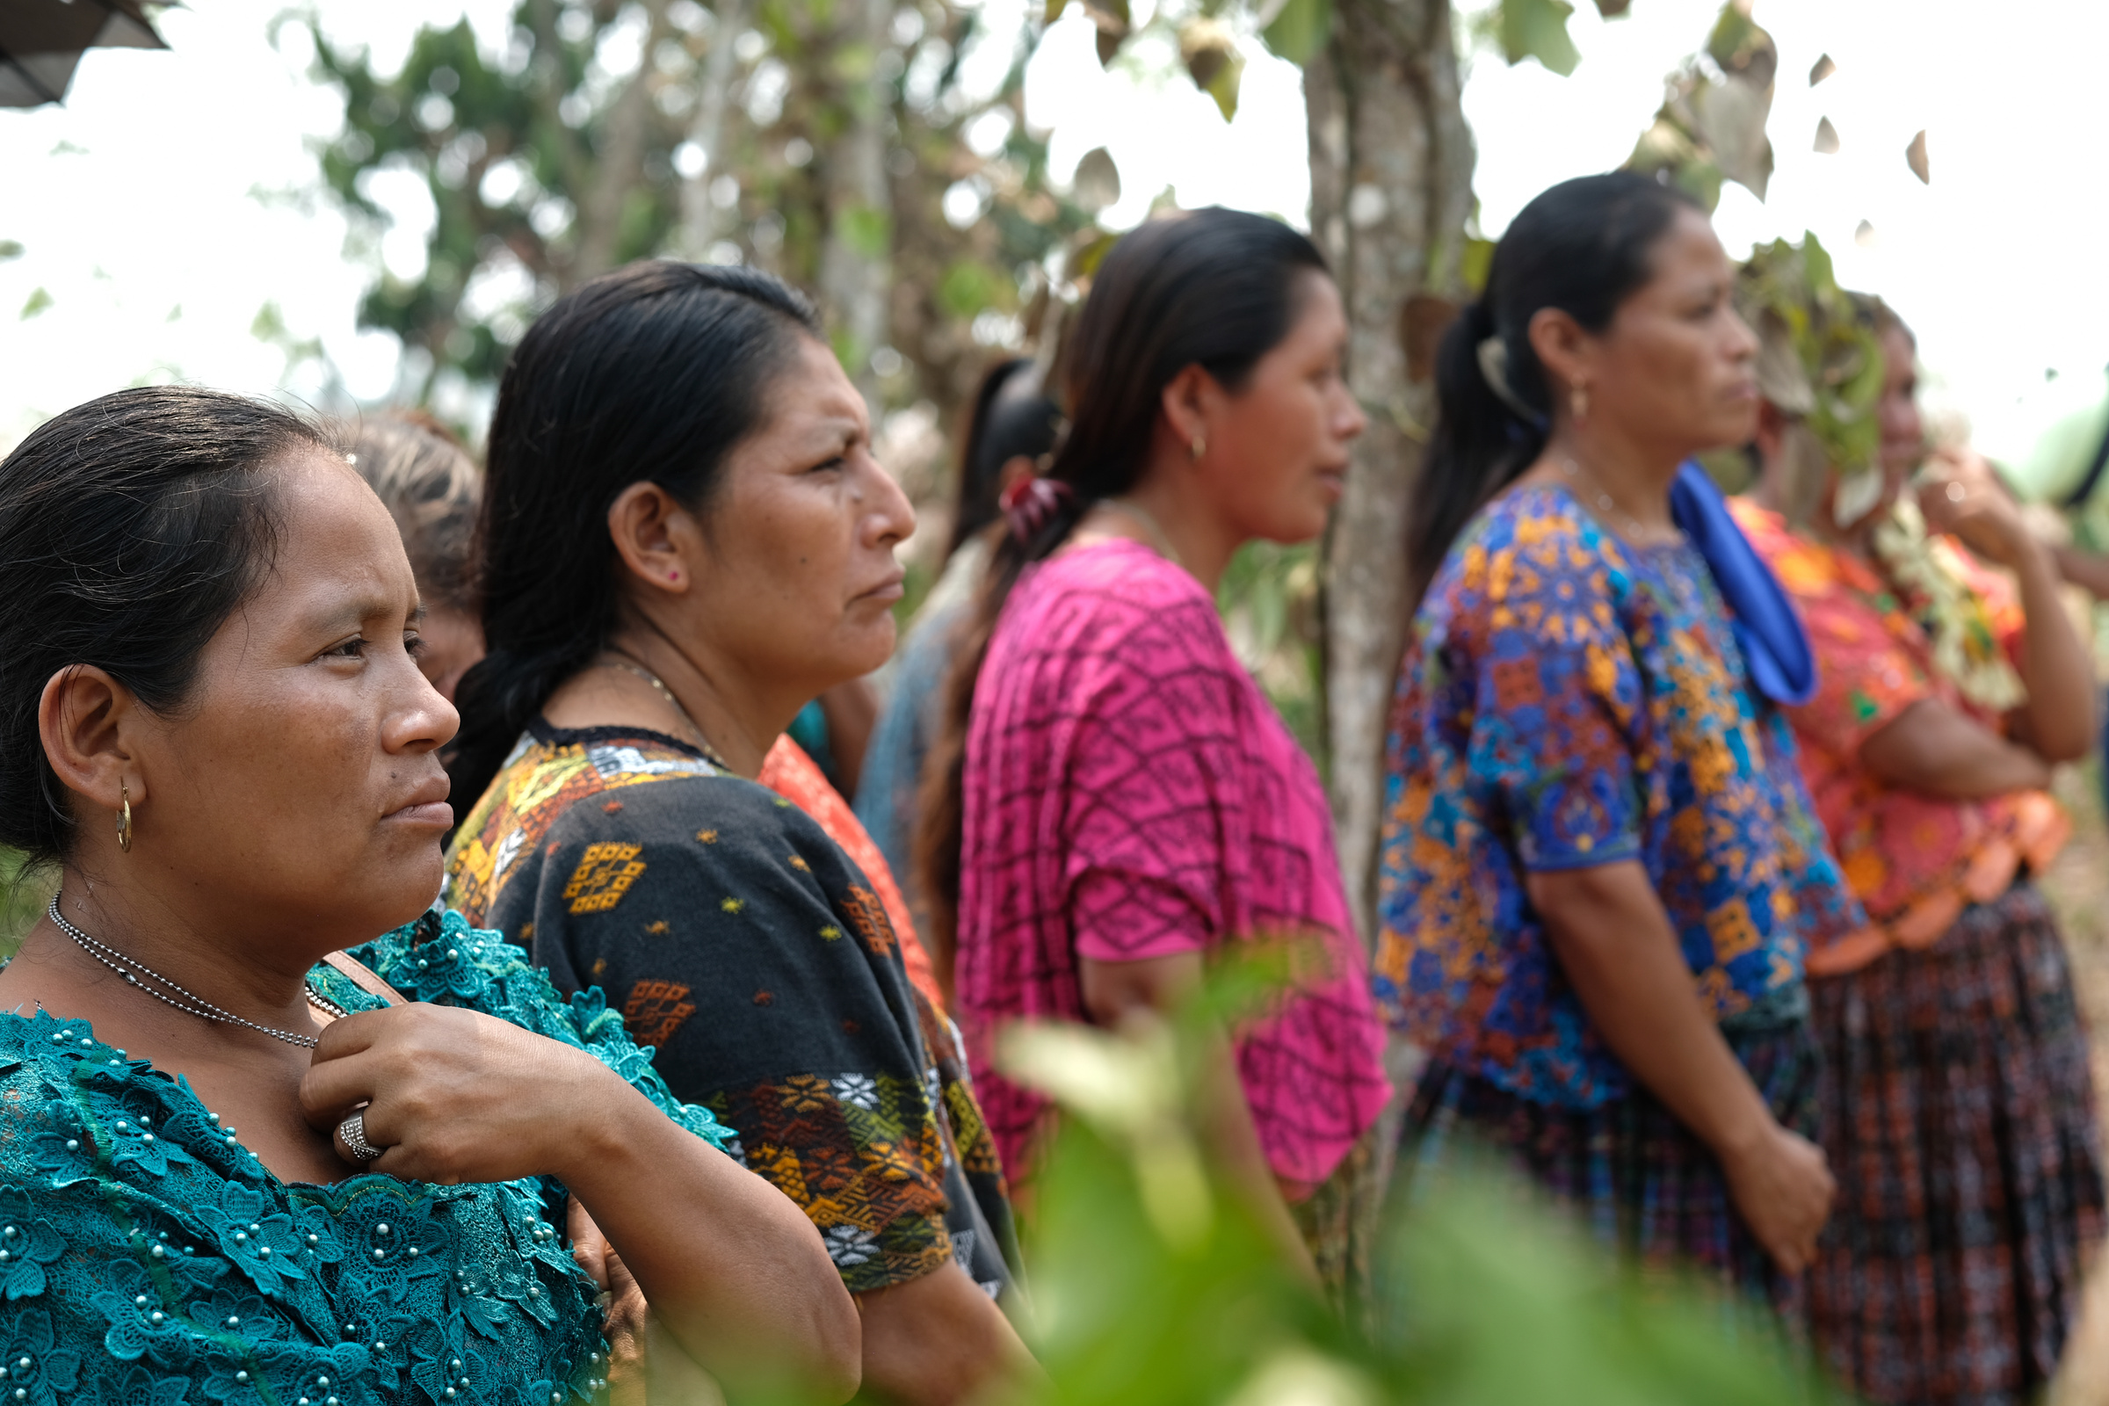
“
I believe women have a lot of capacity. I reject and disagree with the exclusion of women and the violation of women’s rights. I have given my life to this work.
Aurelia

Slide 10
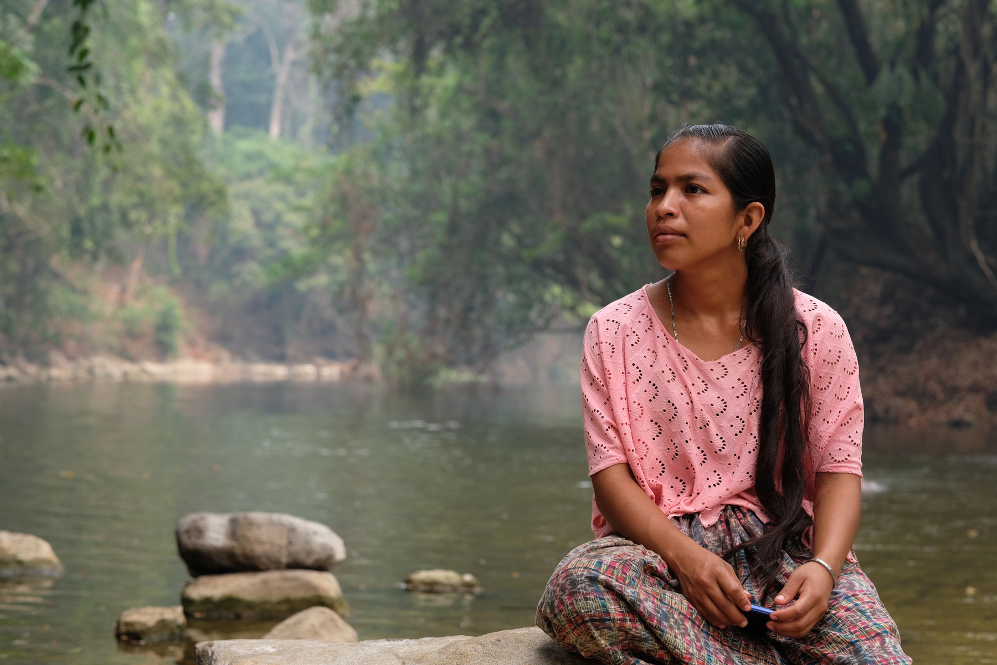
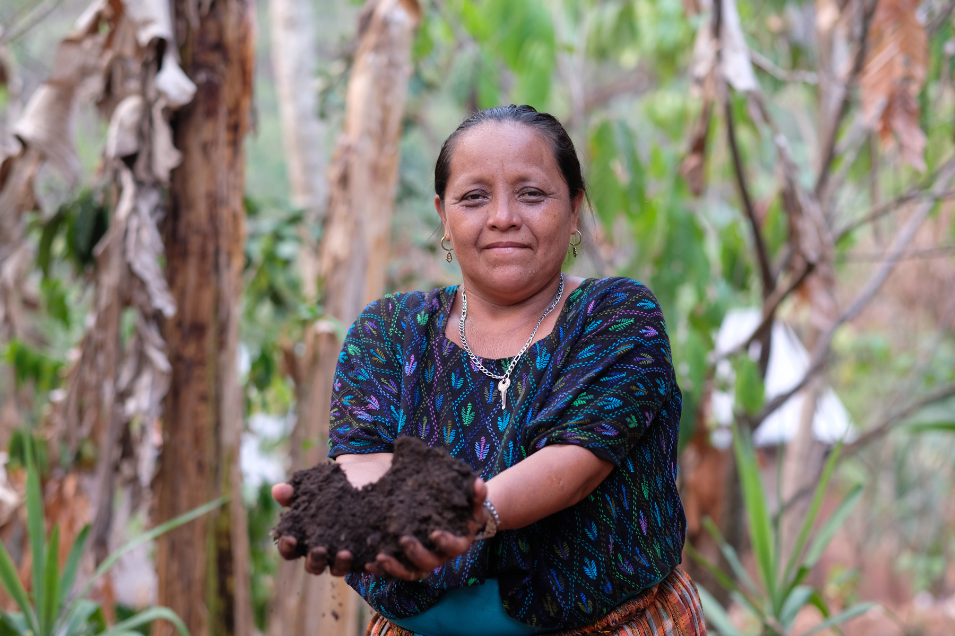
“
I really give my life to my neighbours, sharing my knowledge with them.
Aurelia
“
It’s not fair that people are exploiting our resources and benefiting...there is little we can do but adapt.
Amelia

Slide 11

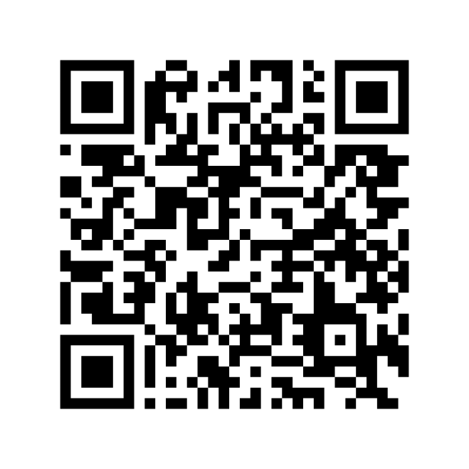
Ways to get involved:
  Fundraise and give
  Join us in prayer
  Campaign with us
  Sign up to stay in touch
scan to donate

